Slide 1
GitHub Pull Requests
Olivier Liechti & Simon Oulevay
COMEM Web Services 2016

Slide 2
What is a pull request?
Pull requests let you tell others about changes you've pushed to a repository on GitHub. Once a pull request is sent, interested parties can review the set of changes, discuss potential modifications, and even push follow-up commits if necessary.
https://help.github.com/articles/using-pull-requests/

Slide 3
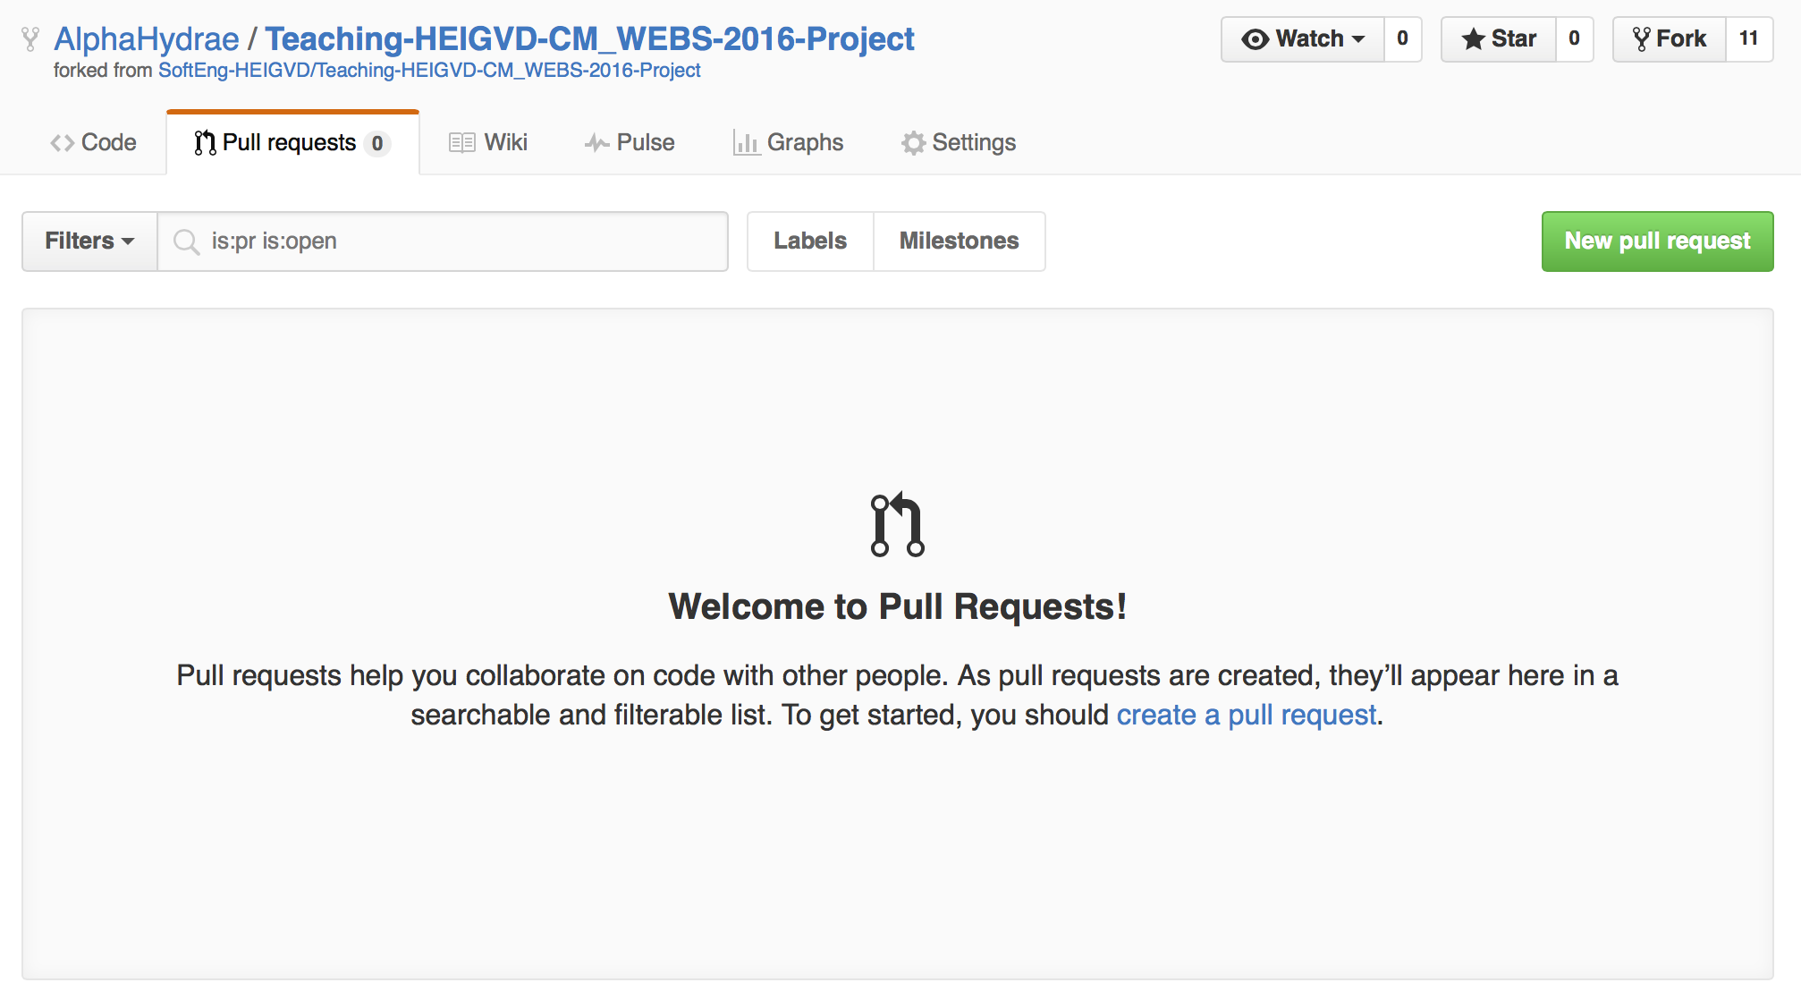

Creating the pull request (1)

Slide 4
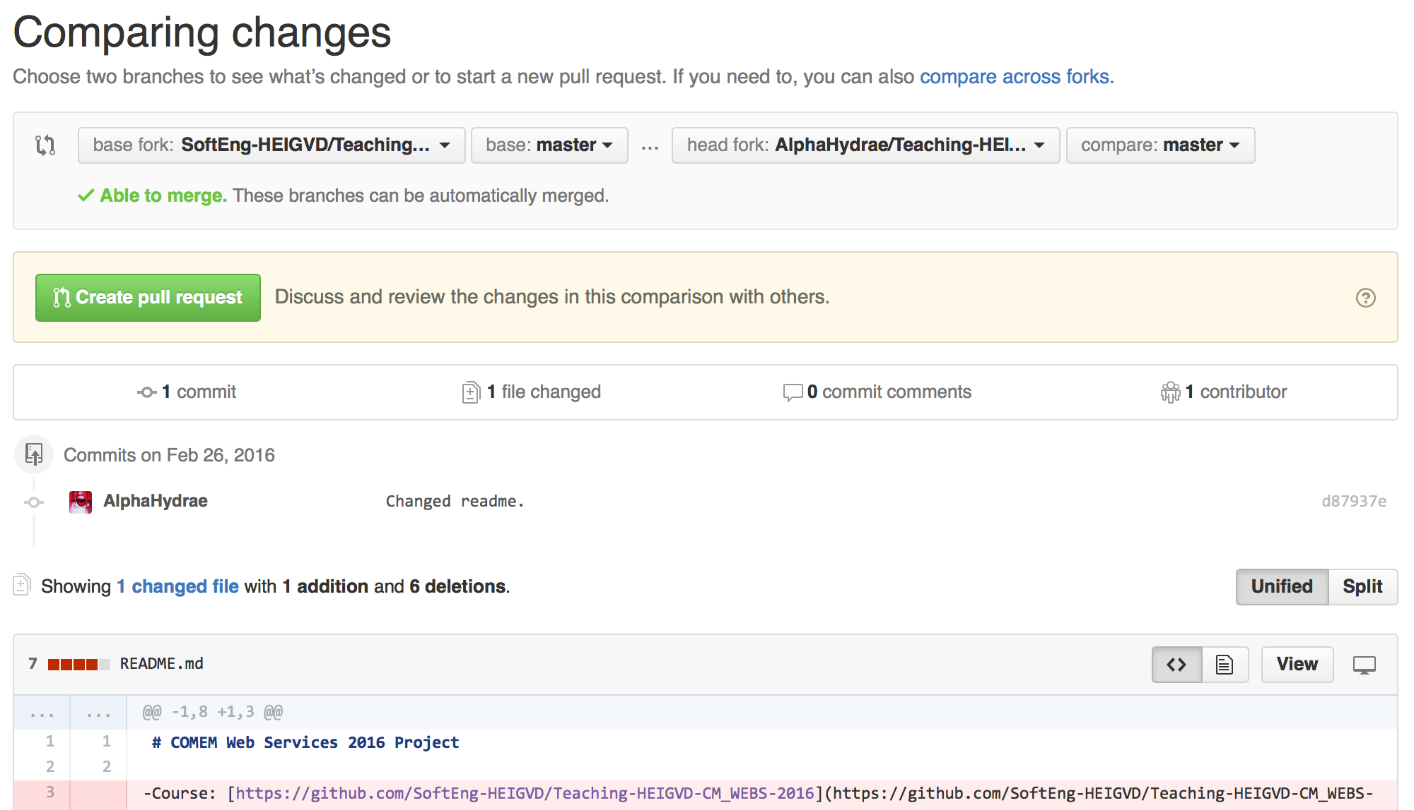

Creating the pull request (2)
This should be our project repository in the SoftEng-HEIGVD organization.

Slide 5
Creating the pull request (3)
This should be your fork of the project repository.

Slide 6

Creating the pull request (4)
This means that you want to pull your master branch into our master branch.

Slide 7

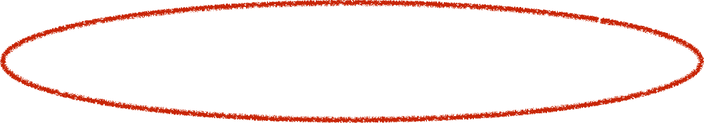
Creating the pull request (5)
The pull request will show you the list of commits and changes you made.

Slide 8

Creating the pull request (7)
If all is good, create the pull request.

